Slide 1

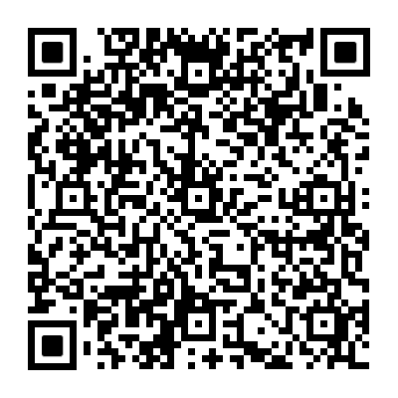

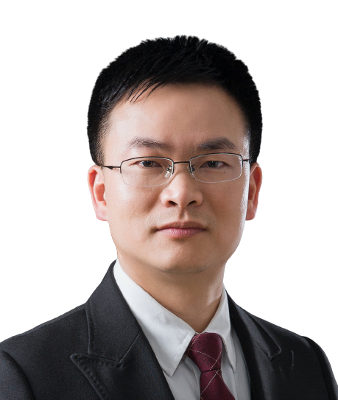
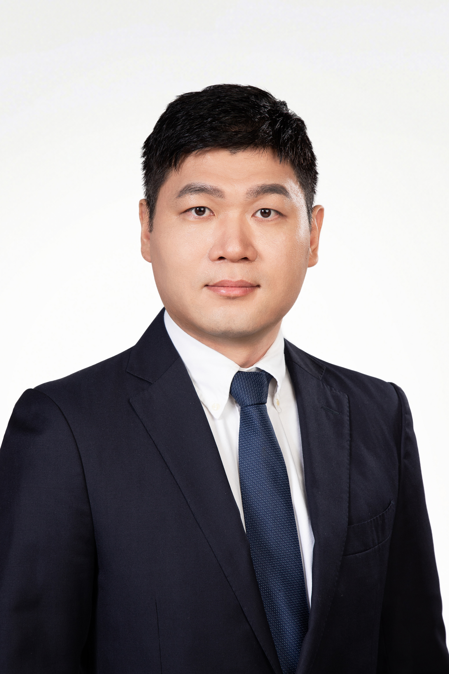
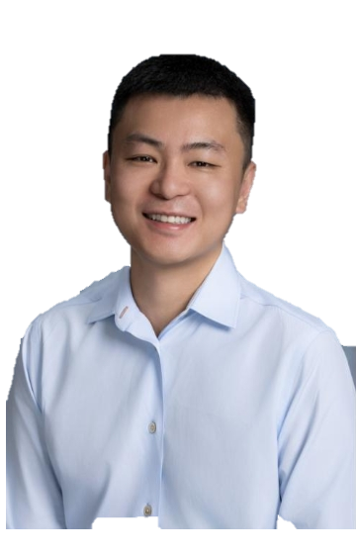
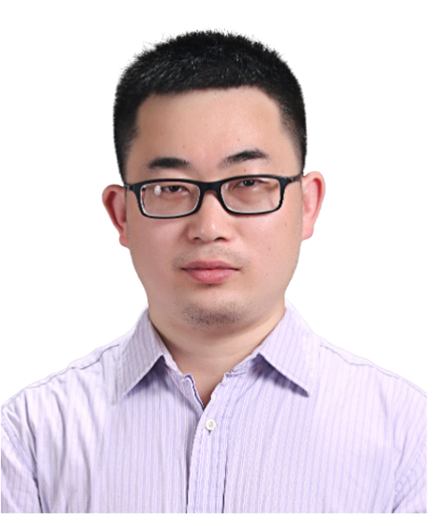

GlycoRNA Biology on the Cell Surface
Time (China): 2024-12-17 9:30 PM
Time (ET): 2024-12-17 8:30 AM
Zoom meeting : 859 6505 9477
Passcode ：123456
Zoom meeting link:
https://us06web.zoom.us/j/85965059477?pwd=eV8b06lLV4vQgf1vNkaI57VsXoHB5R.1
Bilibili：https://live.bilibili.com/26427894
Ryan A. Flynn
Department of Stem Cell and Regenerative Biology
Harvard University | Boston Children's Hospital
Abstract:
Glycans modify lipids and proteins to mediate inter- and intramolecular interactions across all domains of life. RNA is not thought to be a major target of glycosylation. Here, we challenge this view with evidence that mammals use RNA as a third scaffold for glycosylation. Using chemical and biochemical approaches, we found that conserved small noncoding RNAs bear sialylated glycans. These ‘‘glycoRNAs’’ were present in multiple cell types and mammalian species, in cultured cells, and in vivo. GlycoRNA assembly depends on canonical N-glycan biosynthetic machinery and results in structures enriched in sialic acid and fucose. Analysis of living cells revealed that the majority of glycoRNAs were present on the cell surface and can interact with anti-dsRNA antibodies and members of the Siglec receptor family. New chemical tools and insights into the molecular nature of glycoRNAs will be presented, which help to solidify the existence of a direct interface between RNA biology and glycobiology, and an expanded role for RNA in extracellular biology.
HOST＆PANELISTS
Host： Lin Huang
Sun Yat-sen University
Zhichao Miao
Guangzhou Laboratory
Guangzhou Medical University
Yixuan (Axe) Xie
Greater Bay Area Institute of Precision Medicine (Guangzhou)
Jinkai Wang
Sun Yat-sen University
Sponsors

Slide 2
细胞表面糖基化RNA生物学
Time (China): 2024-12-17 9:30 PM
Time (ET): 2024-12-17 8:30 AM
Zoom meeting : 859 6505 9477
Passcode ：123456
Zoom meeting link:
https://us06web.zoom.us/j/85965059477?pwd=eV8b06lLV4vQgf1vNkaI57VsXoHB5R.1
Bilibili：https://live.bilibili.com/26427894
Ryan A. Flynn
哈佛大学干细胞与再生生物学系
波士顿儿童医院
摘要：
糖质可以修饰脂质和蛋白质，调节所有生命领域的分子间和分子内的相互作用。而通常人们认为，RNA不是糖基化的主要载体。在我们的研究中，有足够的证据表明哺乳动物可以将RNA作为第三种糖基化的生物分子，这挑战了传统的生物学理念。通过化学和生化方法，我们发现保守的小非编码RNA带有唾液酸化糖质分子。这些“糖RNA（glycoRNAs）“存在于多种细胞类型和哺乳动物物种中，在培养细胞和体内都有发现。糖基化RNA的合成依赖于经典的N-糖基生物合成机制，并使其糖质结构富含唾液酸和岩藻糖。通过对活细胞的分析显示，大多数糖基化RNA存在于细胞表面，并能与抗双链RNA抗体和小唾液酸受体家族的成员相互作用。在这次的报告中，将阐述新的化学工具和对糖RNA分子的解析，这有助于巩固RNA生物学和糖生物学之间的直接连接，以及扩展RNA在细胞外生物学中的作用。
主持人＆嘉宾
主持人：黄林
中山大学孙逸仙纪念医院
苗智超
广州实验室
广州医科大学
谢一轩
粤港澳大湾区精准医学研究院
王金凯
中山大学
赞助商

